Slide 1
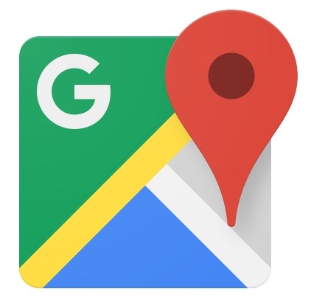
Google Maps
Current Restaurant Wait Time Proposal
Presenter: Atif Ahmad

Slide 2
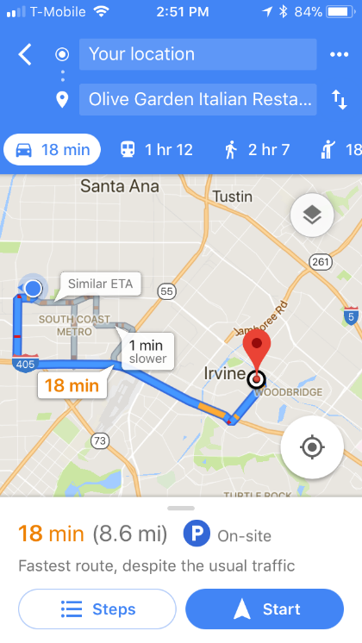
What is Google Maps?
An app that provides driving directions to users
Lists length of time it will take to get
to one’s destination
Along the way, nearby restaurants are listed

Slide 3
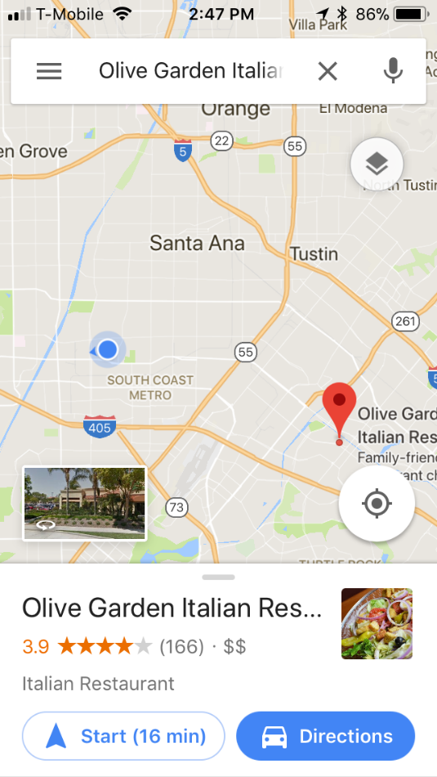
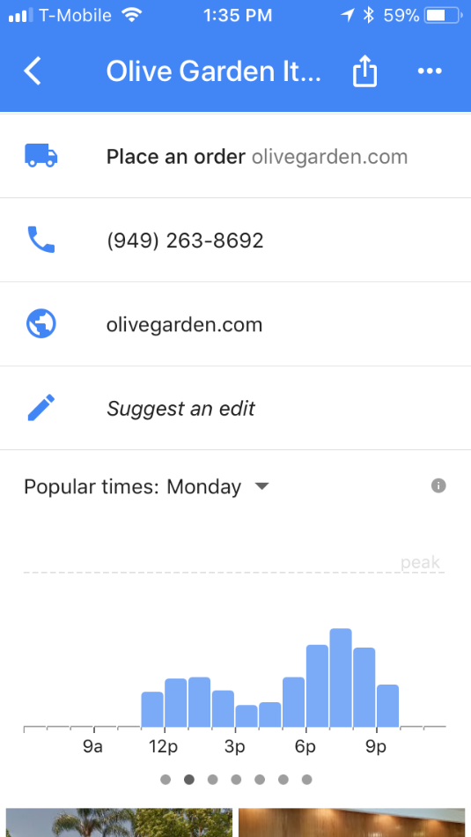
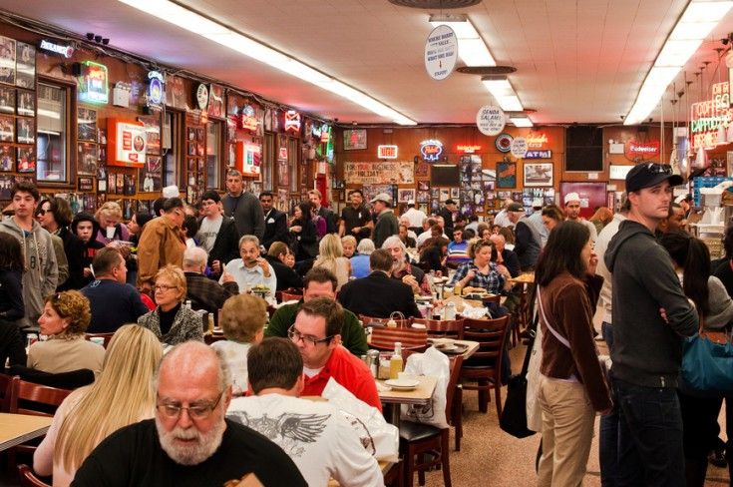
The Problem
People need to call the restaurant in order to know its current wait time
People do not know if a restaurant is crowded or not at a particular time

Slide 4
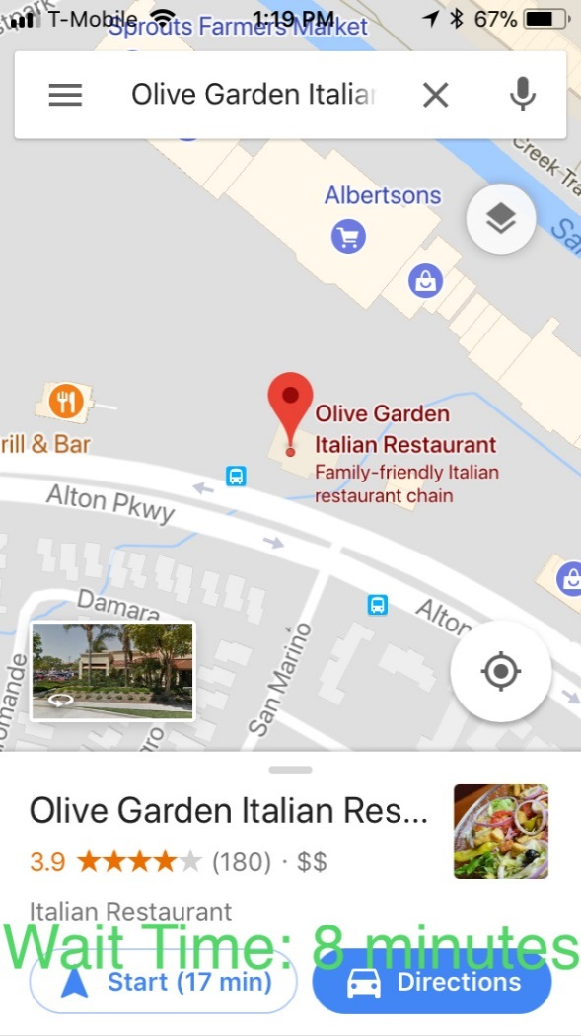

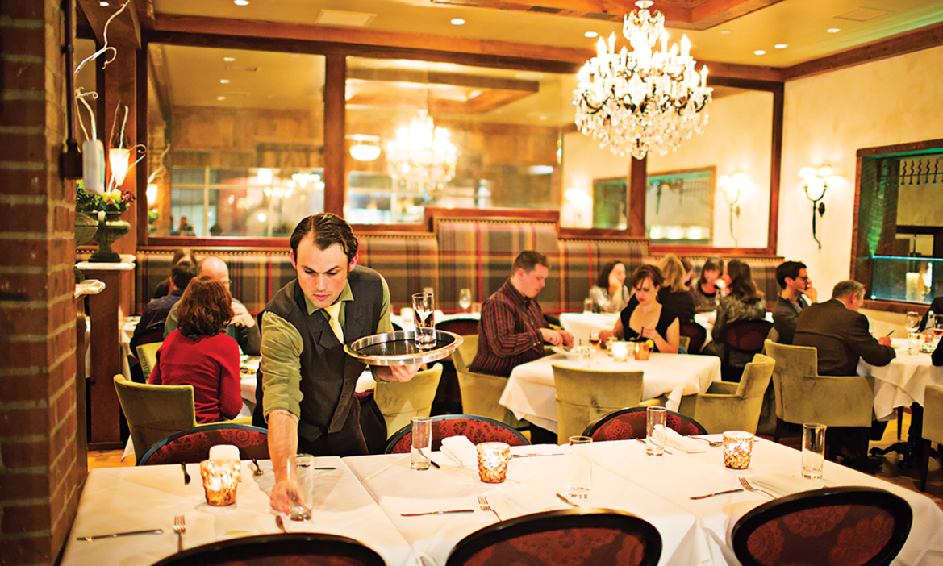
The Solution
Add current restaurant wait time to Google Maps

Slide 5
Benefits
Provides the company with a competitive advantage
Saves the customer’s time
Provides convenience to the user

Slide 6
Market Size
Software publishing is a $218.4 billion industry in 2017
Annual Growth from 2017 - 2022: 2.9%
Source: “IBISWorld Industry Report 51121 Software Publishing in the US.” IBIS WORLD (2017).

Slide 7
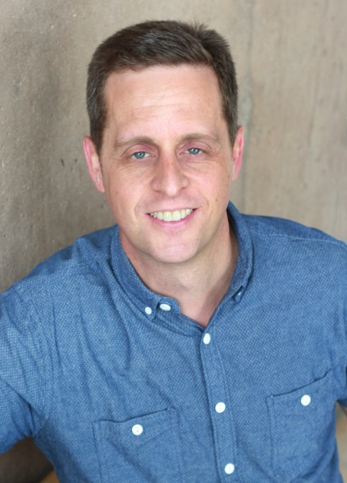

Project Team
Erik Sudderth
Ph.D. professor at UC Irvine
Research experience in machine learning
Role: Data Scientist/Software Engineer
Jen Fitzpatrick
Project Team Lead on Google Maps
Experience developing Google Maps
Role: Project Team Lead

Slide 8
Costs
The project will cost $240,000
Team members will work a 40 hour work week
Source: Glassdoor.com, Glassdoor Inc, 2017.
Position | Name | Hourly Salary | Total Salary (40 Hours/Week)
Data Scientist/Software Engineer | Erik Sudderth | $52.40 | $109,000
Project Team Lead | Jen Fitzpatrick | $62.98 | $131,000
Total |  |  | $240,000

Slide 9
Schedule
Week | Phase | Description | Team Members
1 | Planning | Plan out the process for adding the feature. | All team members
2 | Modeling | Conduct the statistical work needed to implement the project. | Erik Sudderth and his team
3-5 | Development, Implementation, and Integration | Software development of the update. Combines subprograms into one program. The project team checks whether the software product runs on various systems. | Erik Sudderth and Jen Fitzpatrick
6 | Testing | Test the software for bugs and errors. | Jen Fitzpatrick and her team
7-8 | Customer Response | A small user base of customers tests the software. The customers later provide user feedback. | Jen Fitzpatrick
9-10 | Make Necessary Changes to the Software | Changes are made to the software according to the necessary customer feedback after the Customer Response phase. | Jen Fitzpatrick and her team
11-12 | Testing | Final software testing before being released to the public. | Erik Sudderth and Jen Fitzpatrick
The project will take 12 weeks to complete
The project will follow an agile-development process

Slide 10
Summary
Gives a competitive advantage to the company
Saves the customer’s time
Provides all the needed information about the restaurant in one app
Makes Google Maps more functional
Google Maps will benefit from this feature

